Slide 1
Lecture 16
Cryogenic Safety
J.G. Weisend II

Slide 2
Cryogenics Presents
Unique Safety Hazards
Behavior of materials at cryogenic temperatures
Impact of cryogens on people
Over pressurization and bursting hazards due to large volume changes between liquid and vapor
Oxygen deficiency hazards
Flammability of hydrogen or LNG
Impact of LOX on combustibility of materials
Large amounts of stored energy in superconducting magnet systems
Hazards (sometimes lethal) exist in all sizes of cryogenic installations from the largest industrial site to the smallest university lab

Slide 3
Cryogenic Hazards are Manageable
Always conduct a safety analysis of a cryogenic system - no matter how small the system
Consider safety from the beginning of the design
  Retrofitting can be very expensive
  Consider both normal and all possible abnormal operating conditions
  Ask “what if “ questions
Have safety calculations and designs reviewed either internally or externally
Build redundancy into safety systems – no single point failure should cause a hazard
Ensure personnel are aware of hazards and properly trained
Take advantage of previous work and outside resources - Codes, Regulations, National Labs, CGA

Slide 4
Class Content
During this lecture, I will cover some, but not all, cryogenic safety issues
  Impact of Material Choices & General Cryogenic Safety
  Oxygen Deficiency Hazards
  Pressure Safety in Cryogenics
I will illustrate with example accidents to show what can go wrong
I will list best practices for each topic covered
I will provide lists of resources for additional learning
Please ask questions

Slide 5

Impact of Material Choices
& General Cryogenic Safety

Slide 6
Example Accident
October 20, 1944, Cleveland, Ohio
  Sudden failure of an LNG tank at the East Ohio Gas company releases 1.1.million gallons of LNG which quickly ignites causing fires and explosions
  LNG and very cold gas vapor flows into sewar system spreading the fire
  A second LNG tank fails due to the fire releasing an additional 500,00 gallons of LNG that also ignites
  LNG plant is located in a mixed residential and industrial neighborhood
  128 deaths, damage to more than 200 buildings (80 of which completely destroyed) Roughly 3600 people made homeless

Slide 7
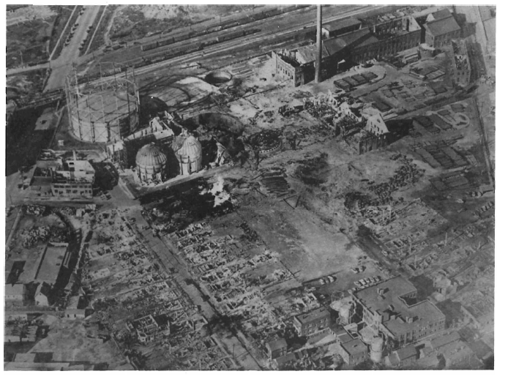
Resulting damage from the 1944 Cleveland LNG Fire and explosion. Gas plant located in the upper half of the picture; note destroyed homes, factories and other buildings in the lower half

Slide 8
What Happened ?
The Impact of the Cleveland fire greatly delayed the use of LNG storage in the USA
Its important to point out that today’s LNG systems are much safer – for starters we put storage facilities in remote locations.
No official, single cause of the event was determined. However, suspicion did fall on the material of the LNG tank (3.5% nickel low carbon steel) This material was known to be brittle at these temperatures but was judged suitable for use and had been used successfully on other LNG tanks. One of the recommendations of the resulting Bureau of Mines investigation was that such material should not be used in the particular cylindrical tank design employed in Cleveland unless it could be established conclusively that the material choice was not a cause of the accident. This material is not used today for LNG systems
An additional contributing factor was the higher density of the cold gas allowing it to seep into sewars etc. This was an unanticipated effect. Minimal containment dikes surrounded the tanks (this is also different today)

Slide 9
Material Choices & Safety
Properties of both cryogenic fluids and solid materials can affect safety
  Some materials inappropriate for cryogenic use
  Material properties change greatly with temperature and these changes may cause safety issues
Many failures of cryogenic systems can be traced to either using the wrong material or not taking into account the property changes.

Slide 10
Some Appropriate Materials for use in Cryogenics
Austenitic stainless steels e.g. 304, 304L, 316, 321
Aluminum alloys e.g. 6061, 6063, 1100
Copper e.g. OFHC, ETP and phosphorous deoxidized
Brass
Fiber reinforced plastics such as G –10 and G –11
Teflon (depending on the application)
Niobium & Titanium (frequently used in superconducting RF systems)
Invar (Ni /Fe alloy)
Indium (used as an O ring material)
Kapton and Mylar (used in Multilayer Insulation and as electrical insulation
Quartz (used in windows)

Slide 11
Some Unsuitable Materials for Use in Cryogenics
Martensitic stainless steels - undergoes ductile to brittle transition when cooled down.
Cast Iron – becomes brittle
Carbon steels – becomes brittle.
Rubber and most plastics (important exceptions are Kel-F and UHMW used as seats in cryogenic valves)
Notes:
  Carbon steels are sometimes used for room temperature vacuum vessels surrounding cryogenic systems – Care must be taken to ensure that any possible leaks will not result in cooling the outer vessel material below its ductile to brittle transition temperature
  Always check that flows from relief valves etc. do not cool down a nearby material that is not appropriate fro cryogenic use.

Slide 12
Other Issues with
Cryogenic Properties of Materials
Even those materials that are appropriate for use in cryogenics have properties that change significantly as a function of temperature. These changes have to be allowed for in the design and may have safety implications. Two examples of this are Thermal Contraction and Material Strength.
Thermal Contraction – most (though not all) materials used in cryogenics contract upon cooling from room temperature to cryogenic temperatures. This contraction can lead to:
  Unplanned contacts or gaps between adjacent components. This may lead to a material not suitable for cryogenic being cooled down to cryogenic temperatures
  High stress and possible failure in components that are over constrained and don’t allow for this contraction. This is commonly seen in wiring systems that aren’t designed for the contraction.
  Unexpected changes in alignment
Always allow for thermal contraction in system designs

Slide 13
Thermal Contraction Can Be
Quite Significant
Material | ΔL / L (300 K – 100 K) | ΔL / L (100 K – 4 K)
Stainless Steel | 296 x 10 ⁻⁵ | 35 x 10 ^{–5}
Copper | 326 x 10 ⁻⁵ | 44 x 10 ⁻⁵
Aluminum | 415 x 10 ⁻⁵ | 47 x 10 ⁻⁵
Iron | 198 x 10 ⁻⁵ | 18 x 10 ⁻⁵
Invar | 40 x 10 ⁻⁵ | -
Brass | 340 x 10 ^{–5} | 57 x 10 ⁻⁵
Epoxy/ Fiberglass | 279 x 10 ^{–5} | 47 x 10 ⁻⁵
Titanium | 134 x 10 ⁻⁵ | 17 x 10 ⁻⁵

Slide 14
Some Properties of Cryogenic Fluids
Fluid | Normal Boiling Point (K) | Density of Liquid at Normal Boiling Point (Kg/m³) | Density of Gas at 1 Bar and 300 K (Kg/m³) | (Volume of gas at 1 Bar, 300 K) / (Volume of liquid at normal boiling point)
Propane | 231.07 | 580.89 | 1.80 | 323
Ethane | 184.55 | 543.97 | 1.22 | 446
Xenon | 165.04 | 2942.1 | 5.29 | 556
Krypton | 119.77 | 2416.3 | 3.40 | 711
Methane | 111.63 | 422.42 | 0.64 | 660
Argon | 87.28 | 1395.5 | 1.62 | 861
Oxygen | 90.19 | 1142.2 | 1.3 | 879
Nitrogen | 77.2 | 807.3 | 1.12 | 720
Neon | 27.09 | 1205.2 | 0.81 | 1488
Hydrogen (Para) | 20.23 | 70.85 | 0.081 | 875
Helium | 4.222 | 125.2 | 0.16 | 783

Slide 15
Cryogenic Fluid Properties
Note the large volume ratio between liquid at boiling point and gas at room temperature and pressure
This effect drives:
  Oxygen Deficiency Hazards
  Pressure safety issues in confined volumes
Compare room temperature and pressure densities with that of dry air (1.2 kg/m³) – Argon and Krypton will tend to accumulate in low spaces while helium and hydrogen will tend to accumulate under ceilings
  Remember lesson learned from the Cleveland fire: in a spill or leak it may NOT be true that all the material goes to room temperature and pressure right away. Thus even Helium, Hydrogen and LNG may flow into low lying spaces

Slide 16
Cryogenic Fluid Properties
Flammability Hazards
  Hydrogen, Propane, Methane and Ethane are all flammable and require specialized handling and safety procedures (LNG is > 95% Methane along with some propane and ethane)
  Note that hydrogen has 2 forms (ortha and para) with different properties.

Slide 17
Cryogenic Fluid Properties
  Oxygen is enables combustion and greatly increases fire risk and impact of resulting fires. It also requires special handling and procedures
  Due to the difference in boiling points between nitrogen and oxygen, air condensing on LN₂ cooled surfaces will be oxygen rich and thus present a hazard – care should be taken to either insulate lines to prevent condensation or to prevent the condensate from coming into contact with fuel and or ignition sources
    A similar hazard can arise when using charcoal adsorbers cooled to liquid nitrogen temperatures in cryogenic plants or gas purification systems. If the flow stream moving through the adsorber has a sufficient oxygen content, the oxygen can condense of the charcoal thus mixing both a fuel (charcoal) and oxidizer (oxygen) together. Under these cases explosions can and have occurred. It may well be better to use noncombustible adsorbing material such as silica gel or molecule sieves in applications where significant oxygen content may be present.

Slide 18
Impact of Ionizing Radiation on LN₂
Liquid nitrogen can contain oxygen impurities either through production or through condensation of air into the LN₂ during transport and use.
Ionizing radiation can convert some of this oxygen (O₂) into ozone (O₃) The ozone can then convert back to O₂ releasing enough energy to cause an explosion. Explosions have been observed in LN₂ systems exposed to large amounts of ionizing radiation. Examples have been observed with gamma rays, neutrons and high energy electrons.
The details of this phenomena are not completely understood and there may also be some additional contributions due to the formation of various nitrogen-oxygen compounds in the irradiated system. The radiation dose required for this phenomenon to occur is generally quite high, but there have been cases reported at lower doses as well
Given the uncertainty surrounding this hazard, it is best not to subject LN₂ systems (and also liquid oxygen or liquid air systems) to ionizing radiation. At the very least, this hazard must be considered and the risk determined prior to operation.
An additional reason for avoiding the use of nitrogen in accelerator tunnels (where it might be subject to ionizing radiation) is the oxygen deficiency hazard posed by the nitrogen.

Slide 19
General Cryogenic Safety

Slide 20
Cryogenic Hazards
In addition to the very important hazards of Oxygen Deficiency, Pressure Safety, flammability and use of liquid oxygen; hazards in cryogenic facilities are related to the extreme cold of the cryogenic liquids and gases.
This extreme cold can result in eye injury and blindness and tissue damage “burns”
The solution for safe work is awareness of this hazard and use of the appropriate Personal Protective Equipment (PPE)
Additionally, many cryogenic systems operate under pressure or can generate pressure to heat leaks and evaporation of cryogens. This can cause risks during handling and cryogenic transfer operations

Slide 21
Personal Protective Equipment
(PPE) for Cryogenic Operations
PPE requirements may vary between institutions but the recommended minimum set of PPE is:
  Eye protection via safety goggles or safety glasses with side shields
  Face protection via face shield (A face shield does not provide eye protection, safety glasses still need to be worn under it)
  Easily removable insulated gloves appropriate for cryogenics (NOT clean room gloves, cotton or wool gloves which can wick the cryogenic liquid to your skin and hold it there - increasing damage)
  An insulated apron to protect against splashing
  Long pants without cuffs that cover the tops of your shoes
  Closed toed shoes

Slide 22
PPE for Cryogenic Operations
This PPE should be worn whenever handling open containers of cryogens, transferring cryogens between containers ( including filling LN₂ dewars) transferring cryogens from a liquid trailer, and pulling or inserting bayonet connections (or U-tubes)
Operation of sealed cryogenic systems such as those cooled by cryogenic plants may not require this level of PPE. However, if maintenance activities take place that could expose you to cryogenic temperatures then the PPE should be worn.
  Perform a hazard analysis for all tasks to see if additional PPE is required
ALWAYS wearing eye protection in a cryogenics facility is a good practice and required in many institutions.

Slide 23


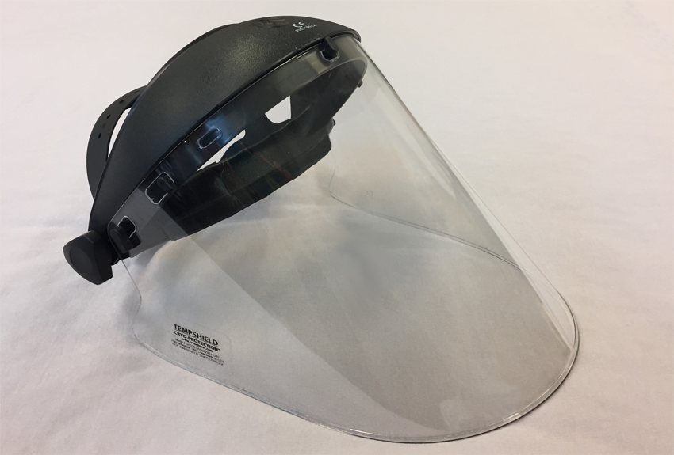
PPE Examples
From TempShield http://www.tempshield.com

Slide 24
Additional Comments on General Cryogenic Safety
Keep in mind that materials that have been splashed by cryogenic liquids or exposed to cold venting vapor may be cooled down to the extent that they now can cause tissue damage
  Be aware when touching these (Gloves)
  Design pressure relief systems and vents so that cold vapor is not directed onto other materials or into places where personnel are likely to be (e.g. transport aisles)
Do not walk into visible vapor clouds. In addition a very real Oxygen Deficiency Hazard, the vapor might be cold enough to cause tissue or eye damage
Do not become complacent when working with LN₂ Even small amounts can cause eye or tissue damage.
  Can we please stop with LN₂ cocktails ?

Slide 25
Additional Comments on General Cryogenic Safety
Ensure that all cryogenic systems are depressurized before:
  Pulling U-tubes or bayonets
  Opening valves, flanges or container lids
  Connecting or disconnecting hoses or piping
Note that small unavoidable heat leaks will result in pressure increase due to evaporation in any sealed system containing liquid cryogens or even cold gases.
  Therefore Never place cryogenic fluid or cold gases into any closed container not specifically designed for them (household Thermos bottles are particularly dangerous)
  Never defeat or bypass pressure safety relief systems.
  Insertion of warm line or U-tubes into cryogens (e.g. LN₂) will cause rapid boiling, pressure rise and /or venting. Always allow for this hazard in the operation.

Slide 26
Summary - Best Practices
Only use materials at cryogenic temperatures that have been proven to operate at these temperatures
Always conduct an Oxygen Deficiency Hazard analysis when using cryogenic fluids or inert gases no matter how small the quantity involved.
Always take into account the volume expansion and subsequent pressure rise associated with cryogenic fluids. Design in appropriate pressure relief systems
Always wear appropriate personal protection equipment, including eye protection, when handling cryogenic fluids no matter how small the amount
Ensure that relief valves and vent lines do not direct the flow of cold gas towards people or towards materials not designed for cryogenic temperature use.
Take into account the flammability hazards associated with Hydrogen, LNG and other hydrocarbons.
Take into account the unique hazards associated with oxygen

Slide 27
Summary - Best Practices
Insulate lines and cold surfaces so that air does not condense on them. If this is not possible, install drip trays or other approaches to safely manage the resultant oxygen rich condensate.
Design for the significant thermal contraction that occurs upon cooling many materials down to cryogenic temperatures.
Be aware of and plan for the relative densities of gases used in cryogenics and their relationship to the density of air. Take into account the possibility that vented gases or spilled fluids may not warm up to 300 K immediately.
Ensure that cryogenic systems are depressurized before carrying out activities such as: pulling of bayonets and U-tubes, opening valves, flanges or container lids and connecting or disconnecting piping or hoses
Only use approved containers for storage and transport of cryogenic liquids and cold gases.
Never defeat or bypass pressure relief systems

Slide 28
Irradiation of LN₂ Hazards
References
G. W. Chen, R. G. Struss, “On the Cause of Explosions in Reactor Cryostats for Liquid Nitrogen”, Cryogenics, April 1969
“Explosion Risk in Liquid Nitrogen” ATLAS AOS No 12, CERN (2013).

Slide 29
Oxygen Deficiency Hazards

Slide 30
Example Accident
In March of 1981, three technicians working at the Kennedy Space Center entered a compartment in the aft section of the space shuttle Columbia that had been purged with gaseous nitrogen. Due to a combination of poor communication and inadequate procedures, the technicians were unaware of the presence of an oxygen deficient environment in the compartment. All three technicians collapsed immediately. Two other workers entering the compartment in an attempt to rescue the first three also collapsed. Two of the three initial technicians died and one of the collapsed rescuers died several years later due to complications from the accident
This illustrates several typical features of ODH accidents:
Rapidity of event
Presence of fatalities
Multiple fatalities
Impact on would be rescuers

Slide 31
What are
Oxygen Deficiency Hazards?
Gases used in cryogenic systems such as He, N₂, Ar, H₂ can displace oxygen in an area causing the area to be unsafe for human life
  Any oxygen concentration less that 19.5 % is considered oxygen deficient (OSHA)
There are several aspects to this problem
  Large volume changes from cryogenic liquids to room temperatures gases
  Even small amounts of liquid can be a hazard is the if released into a small enough volume e.g. small rooms, elevators or cars
  Little or no warning of the hazard at sufficiently low O₂ concentrations
  Consequences can easily be fatal
This is not just a problem in large cryogenic installations
  It can easily be a problem in small labs and university settings – in fact, complacency in smaller settings may be an added risk factor

Slide 32
Recall Volume Changes for Cryogenic Fluids from Normal Boiling Point to 300 K & 1 Bar
Fluid | (Volume of gas at 1 Bar, 300 K) / (Volume of liquid at normal boiling point)
Propane | 323
Ethane | 446
Xenon | 556
Krypton | 711
Methane | 660
Argon | 861
Oxygen | 879
Nitrogen | 720
Neon | 1488
Hydrogen (Para) | 875
Helium | 783

Slide 33
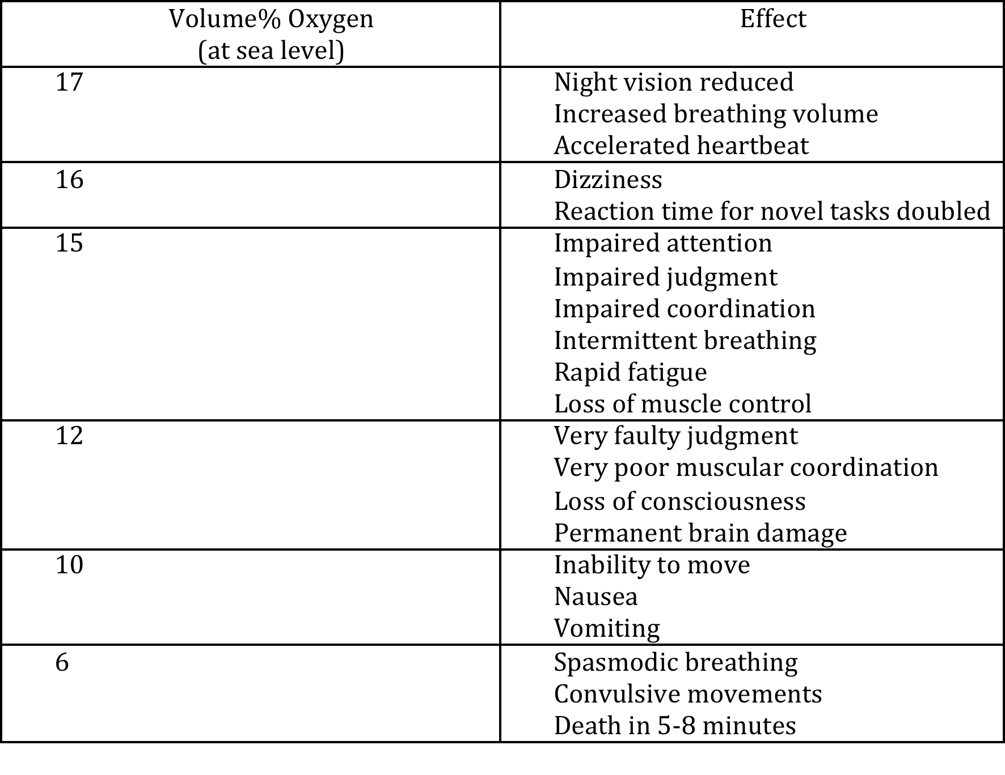
Effects of
Oxygen Deficiency

Slide 34
Approximate time of Useful
Consciousness for a seated subject
at sea level vs % O₂
At low enough concentrations you can be unconscious in less that a minute with NO warning
This is one of the things that makes ODH so dangerous & frequently results in multiple fatalities

Slide 35
ODH Safety Basics
Understand the problem
Determine level of risk
  For each use of cryogenic liquids or inert gases a formal written analysis of the risk ODH posed should be done. The details of this may vary from institution to institution and may be driven by regulatory requirements.
  One technique used by many laboratories (ESS,Fermilab, Jlab, SLAC, BNL) is the calculation of a ODH Fatality Rate. The size of this rate is then tied to a ODH class and each class is linked to specific required mitigations
Apply mitigations to reduce the risk
Have a plan to respond to emergencies
ALL users of cryogenic fluids no matter how small should analyze their risk and consider mitigations
  At a minimum, everyone should be trained to understand the hazard

Slide 36
ODH Mitigations
Best solution: Eliminate the hazard by design choices
  Reduce inventory of cryogenic fluids & compressed gases
    Use minimum amounts of cryogens or oxygen displacing gas
    Restricted Flow Orifaces (RFOs) passive devices used in conjunction with compressed gas systems to reduce the amount of oxygen displacing gas that can enter an area.
  Do not conduct cryogenic activities in small spaces
  Do not transport cryogens in closed vehicles or in elevators with people
  Do not use LN₂ underground
Training
  Everyone working in a possible ODH area should be made aware of the hazard and know what to do in the event of an incident or alarm
    This includes periodic workers such as security staff, custodial staff and contractors
    Visitors should be escorted
Signs
  Notify people of the hazard and proper response
  Indicate that only trained people are authorized to be there

Slide 37
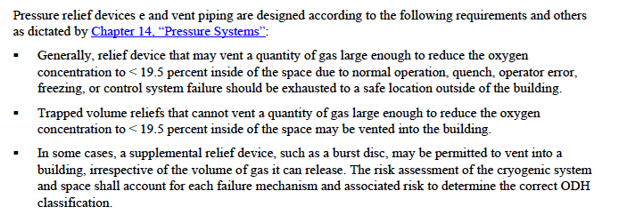
ODH Mitigations
If at all possible vent relief devices outside of buildings
An example policy from SLAC is shown below
Note that this last point can be challenging in tunnel environments

Slide 38
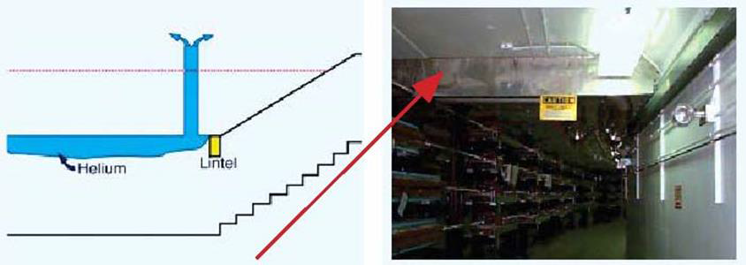
ODH Mitigations
Work Rules
  Prohibit activities that increase risk of an accident
    ESS & CERN: No tunnel entry during cool down and warm up of accelerator
  Two Person Rule
  Three Person Rule (unexposed observer)
Use of lintels and vents to keep helium away from escape routes
  For example at Jlab

Slide 39
ODH Mitigations
Ventilation systems to increase air exchange and reduce the possibility of an oxygen deficient atmosphere forming
  Warning If this approach is taken, the ventilation system must now be treated as a safety system with appropriate controls and redundancies
    What happens during maintenance or equipment failure?
    How do you know ventilation system is working?
ODH Monitors and Alarms
  A very common and effective mitigation. Commercial devices exist.
  Indicates when a hazard exists
  Very valuable in showing if a area has become dangerous during off hours
  Alarms generally set to trip at 19.5% Oxygen
  Alarms should include lights & horn as well as an indicator at entrance to area
  Alarms should register in a remote center (control room or fire dept) as well
  As a safety system it requires appropriate controls & backups (UPS, redundancy etc.)
  In some cases personal monitors will add additional safety

Slide 40
Response to ODH
Alarms & Emergencies
In the event of an alarm or other indication of a hazard immediately leave the area
Do not reenter the area unless properly trained and equipped (e.g. supplementary air tanks)
  Don’t just run in to see what the problem is
Only properly trained and equipped professionals should attempt a rescue in an ODH situation
Response to alarms should be agreed upon in advance, documented and be part of training

Slide 41
ODH Risk Analysis
In many labs e.g. ESS, SLAC, CERN, Fermilab this is done in two steps:
First: a simple calculation that determines if there is any problem at all. This approach compares the volume of the space containing the cryogen with the volume occupied by the inert gas if the entire cryogenic inventory is released, warmed up to 300 K and 1 Bar and uniformly mixed. The resulting oxygen concentration (C) in percent is given by:
Where V_{R} is the volume of the space and V_{C} is the volume of the inert gas at 300 K and 1 Bar
Note: This calculation assumes 1 exchange of the room air per hour.

Slide 42
ODH Risk Analysis
In the case where the inert gas is coming from outside the space, such as in the case of a helium compressor, the oxygen concentration is
Where V_{R} is the volume of the room and Q is the volumetric flow rate of the inert gas at room temperature and pressure. This calculation assumes 1 exchange of the room air per hour.
If either of these oxygen concentrations are less than 19.5% under normal operating conditions or less than 18% under abnormal conditions then a more sophisticated risk analysis is required
Even the simple analysis above (which should be done whenever inert gases or cryogens are used – no matter how small the amount) should be reviewed by an independent analyst and formally documented.
Keep in mind the underlying assumption of uniform mixing. Be aware of helium being trapped at a high level, argon gas concentrated in pits or trenches and the possible effect of gas colder than 300 K

Slide 43
Step 2: A More Detailed
Risk Assessment
This is done by calculating a probable fatality rate (without mitigations) for each possible failure in the system being studied
These are then summed up for a total fatality rate which gives an ODH class
Each ODH class has a set of predefined mitigations
  Required mitigations by class may vary from institution to institution
A key component of this approach is the review of the calculations and mitigations by others (for example an ODH or cryogenic safety committee)

Slide 44
ODH Fatality Rates
where: Φ = the ODH fatality rate (per hour)
P_{i} = the expected rate of the ith event (per hour), and
F_{i} = the probability of a fatality due to event i.
Sum up for all n possible events

Slide 45
ODH Fatality Rates
Probability of an event ( P_{i} ) may be based on institutional experience or on more general data (see handouts)
Probability of a given event causing a fatality ( F_{i} ) is related to the lowest possible oxygen concentration that might result from the event

Slide 46
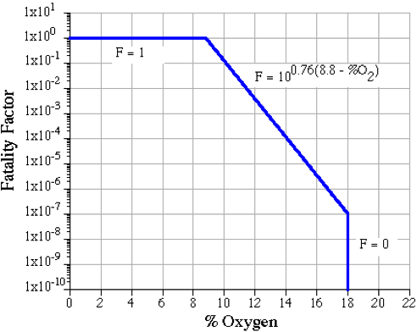
F_{i} vs. Oxygen Concentration (note limits)
This is the same for ESS, SLAC and Fermilab
Note below 8.8% the fatality factor is taken to be 1 as this is the point at which useful consciousness is 1 minute

Slide 47
ODH classes at ESS
ODH Class | [Φ] (hr⁻¹)
0 | ≤10⁻⁷
1 | >10⁻⁷ …but… ≤10⁻⁵
2 | >10⁻⁵ …but… ≤10⁻³
Forbidden area Not permitted at ESS | >10⁻³
Note these are fatality rates without any mitigations
Once the mitigations are applied, the fatality rate should be class 0 or better

Slide 48
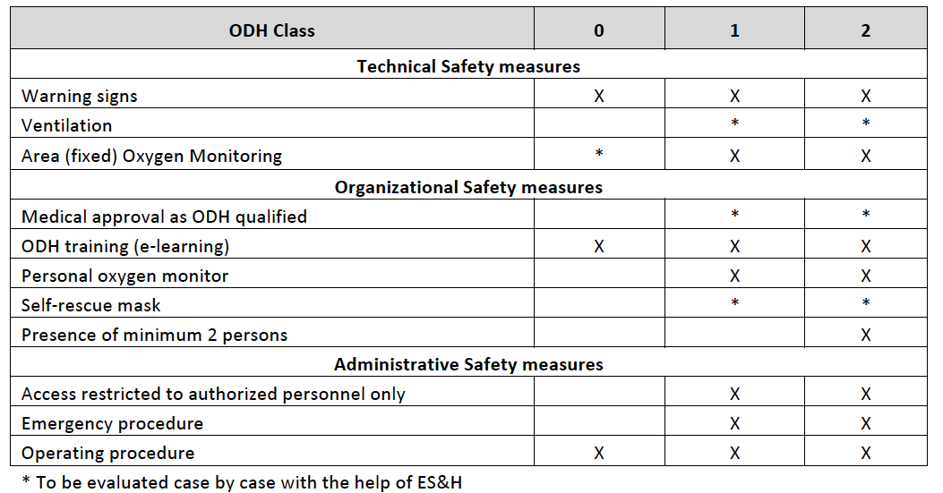
ESS Mitigations vs. ODH Class
(note these are minimum mitigations, additional ones may be required by the safety committee)

Slide 49
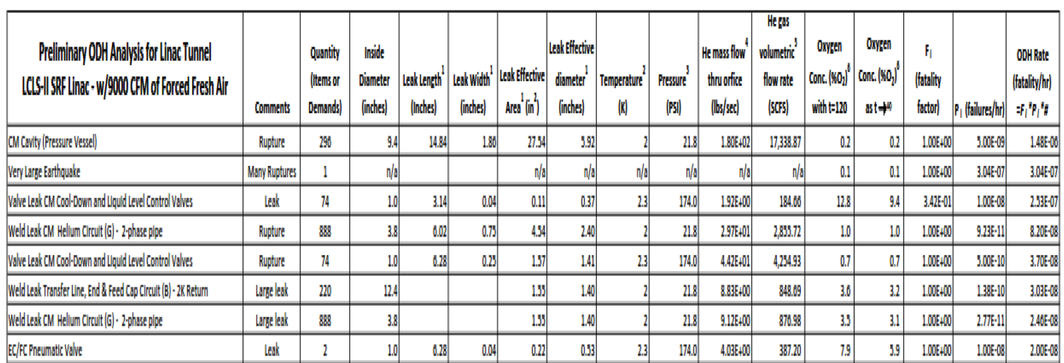
Example Calculation
“ LINAC Coherent Light Source II (LCLS-II) Project Preliminary Oxygen Deficiency Hazard Analyses” - LCLSII-1.1-PM-0349-R1 (see handouts)
This is a very detailed analysis using the SLAC procedures and well worth using as a model
Final result was that the Linac housing (tunnel), Gallery and Cryogenics building were rated as Class 1
Work restrictions on entry into tunnel during cool down and warm up.

Slide 50
ODH and Visitors
Visitors and occasional staff ( guards, custodial, delivery, visiting contractors etc. ) should always be trained in ODH hazards and procedures or escorted by trained staff

Slide 51
Summary
Oxygen Deficiency Hazards are a significant threat and can lead to fatal accidents even with small amounts of cryogens or oxygen displacing gases
ODH can, however, be properly managed to allow safe work in cryogenic facilities
Significant experience with ODH safety exists and resources exist at labs such as ESS, SLAC, Fermilab, Jlab etc. (see handouts)
Do not become complacent!

Slide 52
Best Practices
Always evaluate the risk of an oxygen deficiency hazard whenever dealing with cryogenic fluids or compressed gases, no matter how small the amount.
Develop a well understood and documented approach to evaluating and mitigating oxygen deficiency hazards.
Consider at the beginning of the system design, choices that minimize or eliminate oxygen deficiency hazards. These may include: reducing the cryogenic inventory, limiting the amount of inventory that can be released in an accident, venting relief systems outdoors, maximizing interior space in which cryogenic systems are contained and designing tunnels with sufficient exits and ventilation to reduce ODH risk.
Have all ODH analyses independently reviewed.
Ensure that anyone (including visitors, contractors, maintenance & service staff) working in an ODH area is aware of the hazard and properly trained.
Immediately leave an area in the event of an ODH alarm or other indication of a leak such as a vapor cloud. Do not walk through vapor clouds while exiting.
Never enter an area in which an ODH alarm has sounded or that is otherwise thought to be oxygen deficient unless you have been properly trained and equipped for such entries.
Do not transport even small amounts of cryogenic fluids inside cars or elevators.

Slide 53
Introduction to Pressure Safety

Slide 54

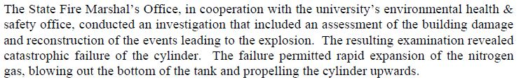
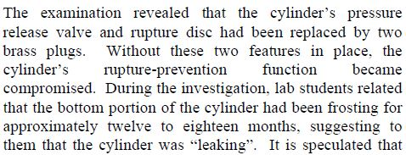
Example accident: LN2 dewar explosion, for the report, see http://www.tdi.texas.gov/fire/documents/fmred022206.pdf

Slide 55

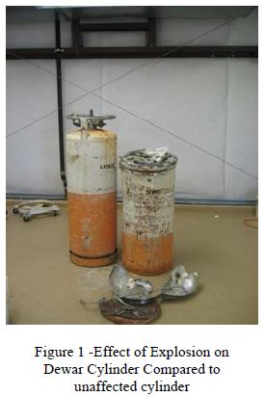
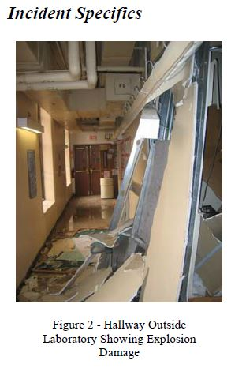
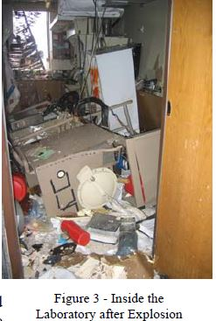

Slide 56
Over Pressurization Hazards
A principal hazard that results from the large volume expansion that occurs when a cryogenic liquid is converted to 300 K gas
As a result large pressure rises are possible
This could easily result in material failures, and explosive bursting

Slide 57
Recall Volume Changes for Cryogenic Fluids from Normal Boiling Point to 300 K & 1 Bar
Fluid | (Volume of gas at 1 Bar, 300 K) / (Volume of liquid at normal boiling point)
Propane | 323
Ethane | 446
Xenon | 556
Krypton | 711
Methane | 660
Argon | 861
Oxygen | 879
Nitrogen | 720
Neon | 1488
Hydrogen (Para) | 875
Helium | 783

Slide 58
The solution is to always install pressure relief devices
Redundant devices should be used. Typically relief valve + burst disc
The device should be set to open at or below the MAWP of the vessel
Valves should be sized for worst case scenarios
Valves should be tested & certified before installation
Ensure that there are no trapped volumes. Remember – valves may leak or be operated incorrectly and cryogenic systems may warm up unexpectedly (vacuum spaces need relief valves as well)

Slide 60
Pressure Relief Systems
The pressure relief of a cryogenic system, particularly in worst case scenarios can be very dynamic with rapidly changing temperatures, pressures, flows and phases.
Sizing of relief valves and associated systems may be proscribed by applicable pressure vessel codes (PED, ASME etc)
Third party inspection and approval is frequently required.
In cryogenic systems the worst case scenario is the breaking of a vacuum system. The in rushing air condenses on the cold cryogenic surfaces and deposits heat into the the cryogenic fluid causing rapid boiling and expansion.
Never place shut off valves between systems and relief valves. In some cases 3 way valves are used with parallel relief valves to allow maintenance

Slide 61
Pressure Relief Systems
Cryogenic systems should be vented into either a recovery system or into the outside air not into tunnels or buildings
Take care that collection headers and recovery systems do not result in the pressure at the relief valves being too high when the system is venting
Never bypass or disable pressure reliefs
Much more detail given in supplemental slides by Tom Peterson (SLAC)

Slide 62
Pressure Safety Best Practices

